Slide 1
Welcome to math!
Miss Pereira
Room 220

Slide 2
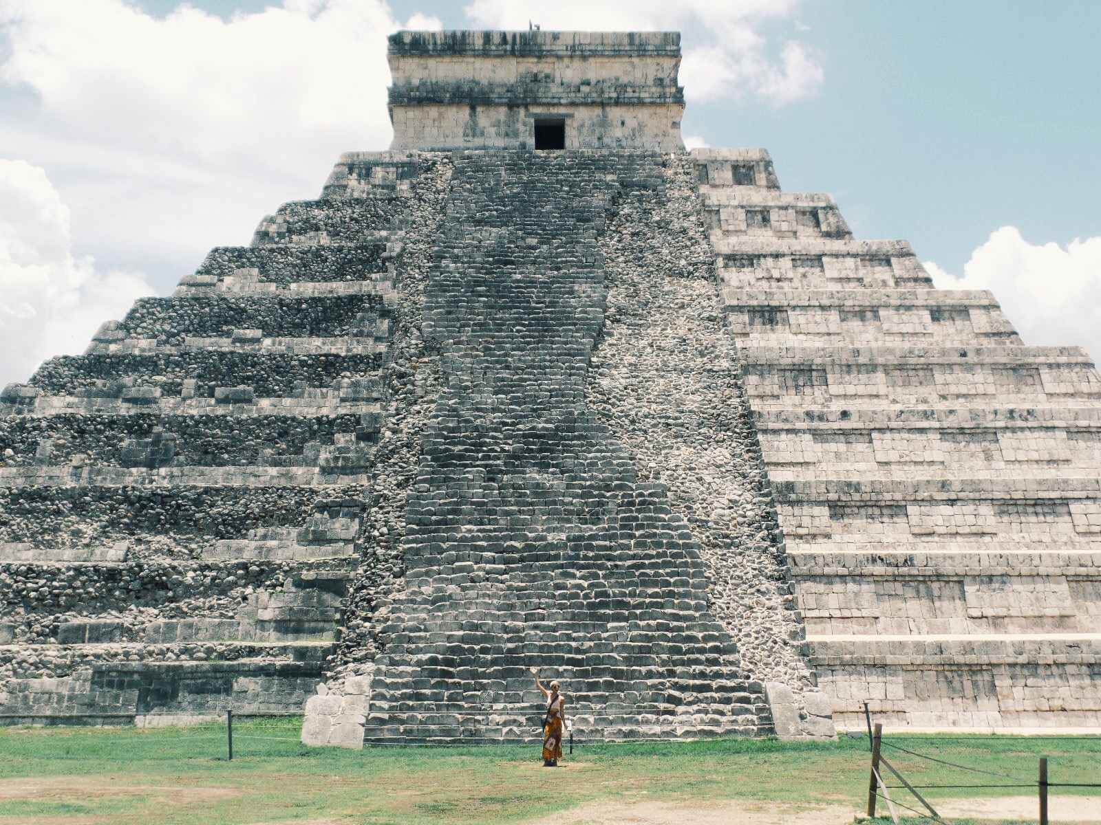
Who am i?
From: Coventry, RI
Education: University of Rhode Island, Class of 2016
Degrees: Applied Mathematics, Secondary Education
What I Love:
Yoga, photography, movies, music, FOOD, traveling, Harry Potter (and many other nerdy stories), humor, my friends and family
What I’m All About (Classroom Philosophy):
Hard Work
RESPECT
YOU!!!

Slide 3
class rules and expectations
Arrive prepared with ALL materials
If you need to borrow a pencil, you will lend me something of yours for the period
Arrive ON TIME (through the door when the bell rings)
Respect
Yourselves
Others
No “put downs” (I DO NOT TOLERATE BULLYING)
No talking back
You have a problem, speak to me in private after class
Property
You break it, you buy it.
Raise your hand, when you have a question or comment.
ABSOLUTELY NO FOUL LANGUAGE
TRY your hardest! Put in effort and try. You will not sit in class and do nothing.

Slide 4
Class rules and expectations
Food
Small snacks: YES
Bottled water: YES
Your whole lunch: NO
Colored Beverages: NO
Phones
Put it in the bin IMMEDIATELY after entering the classroom.
Failure to do so:
1st time: I remind you, you put phone in bin.
2nd time: Detention and call home
3+ times: Detention, Written up

Slide 5
Class rules and expectations
Cheating
ABSOLUTELY NOT TOLERATED
You get:
A zero
Detention
Office Referral
Call home
DO NOT CHEAT. DO NOT CHEAT. DO NOT CHEAT. JUST DON’T DO IT. EVER.

Slide 6
Class rules and expectations
Leaving Class:
YOU NEED A PASS
You cannot make guidance appointments during class. Go in the morning.
Nurse: Only in extreme cases. I will give you a pass, and call Mrs. Grauer.
When you leave, sign the sign out sheet by the door.

Slide 7
Any questions so far?

Slide 8
In your classroom
Student Area:
Handouts for the day always on counter
Scrap, white, lined and graph paper available on racks.
Pencils and art supplies may be borrowed with permission (and you must give me something of yours)
Folder System:
Every student gets a hanging folder with three different colored file folders inside. One red, one yellow, and one purple.
Yellow= turn in
Purple= graded (you may take)
Red= missing

Slide 9
Daily routine
Enter
Place phone in bucket
Look at the white board for Plan of the Day to see what handouts you need, and what work is passed back (in your purple folder)
Check purple folder for corrected work
Put due assignments in yellow folder
If you were absent, grab missed notes and/or assignments from red
Sit in your seat, take out your homework and start the Warm Up problem.
EVERYONE COMPLETES WARM UP PROBLEM
While you do warm up, I check homework.
Sometimes we will go over the warm up.
Lesson begins
At the end of class, return all used materials of mine to their proper places, and throw out ALL garbage (or you will lose the privilege to eat in my class).

Slide 10
In this class you will have:
Tests/ Projects (40% of grade)
Quizzes/Team Tests (25%)
Individual Quizzes
Team Tests: test problems you discuss with your team, but everyone does work for
Homework (20%)
Do your homework, it’s so crucial in Math.
You get either a 100, 75, 50, 0 or incomplete
Classwork/Participation (15%)
Speak up and work with your team when necessary
Take notes
Complete all assignments
You get a grade of 1-4 at the end of the week

Slide 11
Extra help
I’m available before school:
7-7:15 am
Everyday
After school:
2:15-3:00 pm
Mondays, Tuesdays and Thursdays
Always let me know when you plan on coming by, and I will let you know if I’m available (I might have meetings, other obligations, etc.)
If these times do not fit in your schedule, we can discuss a time that works for you.

Slide 12
Contact information
On the poster in class
On my webpage
In the syllabus
I will not respond to emails or messages after 10:00 pm

Slide 13
Any final questions??
(This was a lot of information…you must have some)
Further elaboration can be found in the syllabus

Slide 14
First day plan
Fill out your index card
Give directly to me
Fill out questionnaires
Turn in your yellow folder
Put your name on all three labels I give you
Put those labels on your yellow, purple and red file folders
Place your “bunch” of folders back in your class folder bin
While you do this, you will get called up to setup Remind101 and Google Classroom with me
HOMEWORK:
Get syllabus and parent letter signed
You will get a 100% if you bring in both (EASY 100!!!)

